Slide 1
Web Development using React js
Lecturer name
Lecturer
Faculty of Computer & IT
Jamahiriya University of Science & Technology

Slide 2
Chapter #3
Introducing JSX
Rendering Elements
Components and Props
State and Lifecycle
Handling Events
Introduction to React

Slide 3
Jsx
JSX: It is JavaScript extension where we can embed valid JavaScript objects into HTML elements.
JSX makes Code easier to read and understand. Usually, HTML and JavaScript is written separately but react creates components that contain both HTML and JavaScript. So, if you are familiar with HTML you can easily modify your code using JSX.

Slide 4
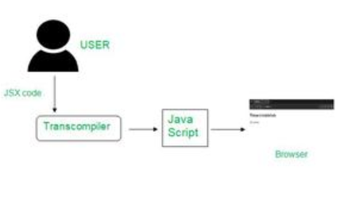
JSX
How JSX works behind the scenes: Most of the users use JSX as it is easy to learn and easy to implement and could find errors easily.
Whenever a code is written in JSX, babel transcompile the code into JavaScript code.

Slide 5
JSX
It is called JSX, and it is a syntax extension to JavaScript. We recommend using it with React to describe what the UI should look like.
JSX may remind you of a template language, but it comes with the full power of JavaScript

Slide 6
JSX
Why JSX?: React embraces the fact that rendering logic is inherently coupled with other UI logic: how events are handled, how the state changes over time, and how the data is prepared for display.
Instead of artificially separating technologies by putting markup and logic in separate files, React separates concerns with loosely coupled units called components that contain both.

Slide 7
JSX
React doesn’t require using JSX, but most people find it helpful as a visual aid when working with UI inside the JavaScript code.
It also allows React to show more useful error and warning messages.

Slide 8
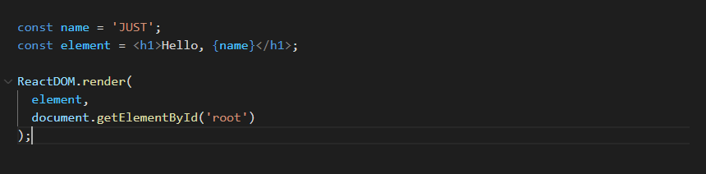
JSX
Embedding Expressions in JSX:
In the example below, we declare a variable called name and then use it inside JSX by wrapping it in curly braces.

Slide 9
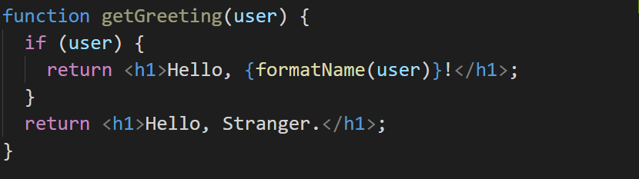
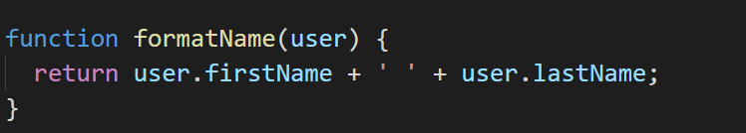
JSX

Slide 10
JSX
Specifying Attributes with JSX: you may use quotes to specify string literals as attributes:
You may also use curly braces to embed a JavaScript expression in an attribute:

Slide 11
JSX
Don’t put quotes around curly braces when embedding a JavaScript expression in an attribute.
You should either use quotes (for string values) or curly braces (for expressions), but not both in the same attribute.

Slide 12
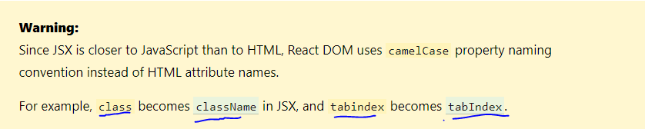
JSX
Specifying Children with JSX
If a tag is empty, you may close it immediately with />, like XML.

Slide 13
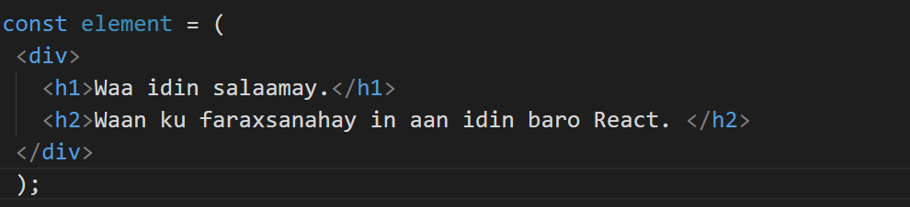
JSX
JSX tags may contain children:

Slide 14

JSX
JSX Prevents Injection Attacks
By default, React DOM escapes any values embedded in JSX before rendering them. Thus it ensures that you can never inject anything that’s not explicitly written in your application. Everything is converted to a string before being rendered. This helps prevent XSS (cross-site-scripting) attacks.

Slide 15
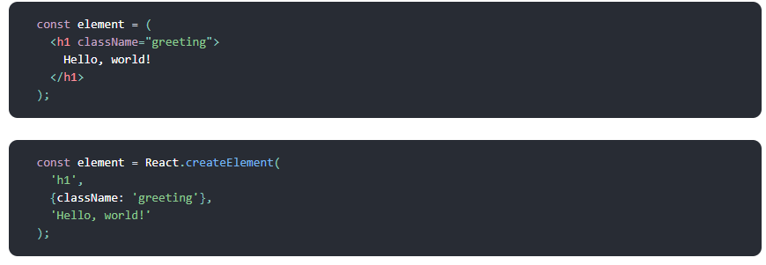
JSX
JSX Represents Objects
Babel compiles JSX down to React.createElement() calls.
These two examples are identical:

Slide 16
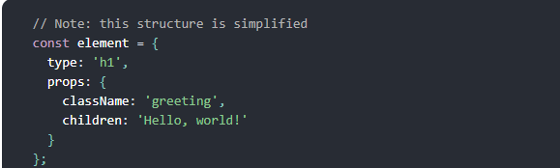
JSX
React.createElement() performs a few checks to help you write bug-free code but essentially it creates an object like the below one

Slide 17
JSX
The objects shown last slide are called React elements. You can think of them as descriptions of what you want to see on the screen.
React reads these objects and uses them to construct the DOM and keep it up to date.

Slide 18
Rendering Elements
Elements are the smallest building blocks of React apps.
An element describes what you want to see on the screen.
Rendering an Element into the DOM
Let’s say there is a < div > somewhere in your HTML file
We call this a root DOM node because everything inside it will be managed by React DOM.

Slide 19

Rendering Elements
Applications built with just React usually have a single root DOM node.
If you are integrating React into an existing app, you may have as many isolated root DOM nodes as you like.
To render a React element into a root DOM node, pass both to ReactDOM.render().

Slide 20
Rendering Elements
Updating the Rendered Element
React elements are immutable. Once you create an element, you can’t change its children or attributes.
An element is like a single frame in a movie: it represents the UI at a certain point in time.
React Only Updates What’s Necessary
React DOM compares the element and its children to the previous one, and only applies the DOM updates necessary to bring the DOM to the desired state.

Slide 21
Components and Props
components describe part of user interface.
Components let you split the UI into independent, reusable pieces, and think about each piece in isolation.
Conceptually, components are like JavaScript functions. They accept arbitrary inputs (called props) and return React elements describing what should appear on the screen.

Slide 22
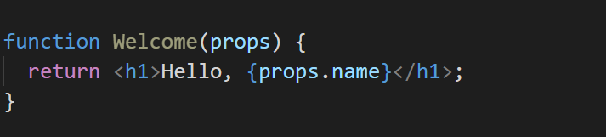
Components and Props
Component types are Function and Class Components.
The simplest way to define a component is to write a JavaScript function.

Slide 23
Components and Props
The function in previous slide is a valid React component because it accepts a single props (which stands for properties) object argument with data and returns a React element.
We call such components function components because they are literally JavaScript functions.
You can also use an ES6 class to define a component

Slide 24
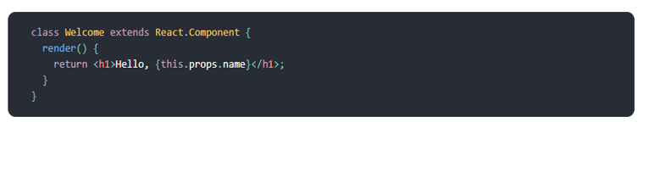
Components and Props
The above two components are equivalent from React’s point of view.
Function and Class components both have some additional features that we will discuss in the upcoming sessions.

